Slide 1
SELECT statement (Part 4)
CSIT882: Data Management Systems
Notes:
<!-- Neural, Brian, Male, British English. --><speak><break time="0.5s"/><prosody rate="90%">SELECT statement, part 4.<break time="0.3s"/>This presentation explains how to implement the outer join queries as SELECT statements.<break time="0.5s"/></prosody></speak>
1
Systems Analysis

Slide 2
Outline
Outer join queries
Left outer join queries
Right outer join queries
Full outer join queries
Grouping revisited
2
Notes:
<!-- Neural, Brian, Male, British English. --><speak><break time="0.5s"/><prosody rate="90%">Outer join queries.<break time="0.5s"/></prosody></speak>
Systems Analysis
2

Slide 3
Outer join queries
Left Outer Join operation joins the rows from two relational tables and appends to the results of the join all rows from the left argument of the operation that cannot be joined with any row from the right argument of the operation with NULLs used in all places where the values are missing
Right Outer Join operation joins the rows from two relational tables and appends to the results of the join all rows from the right argument of the operation that cannot be joined with any row from the left argument of the operation with NULLs used in all places where the values are missing
Full Outer Join operation unions the result of left outer join operation and the results of right outer join operation
3
Notes:
<!-- Neural, Brian, Male, British English. --><speak><break time="0.5s"/><prosody rate="90%">The LEFT OUTER JOIN operation, joins the rows from two relational tables in two steps.<break time="0.3s"/>In the first step, the LEFT OUTER JOIN operation, joins the rows from two relational tables in the same way as the ordinary JOIN operation, also called as: the INNER JOIN operation.<break time="0.3s"/>Next, the LEFT OUTER JOIN operation, appends to the results of the join, all rows from the left argument of the operation and such, that the rows cannot be joined with any row, from the right argument of the operation.<break time="0.3s"/>Finally, the operation inserts a symbol of an empty slot: NULL, into all entries in the columns, where the values are missing.<break time="0.3s"/>The RIGHT OUTER JOIN operation, joins the rows from two relational tables in almost the same way as the LEFT OUTER JOIN operation.<break time="0.3s"/>In the first step, the RIGHT OUTER JOIN operation joins the rows from two relational tables in the same way as the ordinary JOIN operation.<break time="0.3s"/>Next, the RIGHT OUTER JOIN operation, appends to the results of the join, all rows from the right argument of the operation and such, that the rows cannot be joined with any row from the left argument of the operation.<break time="0.3s"/>Finally, the operation inserts a symbol of an empty slot: NULL, into all entries in the columns, where the values are missing.<break time="0.3s"/>The FULL OUTER JOIN operation unions the result of: the LEFT OUTER JOIN operation and the results of: RIGHT OUTER JOIN operation.<break time="0.5s"/></prosody></speak>
Systems Analysis
3

Slide 4
Outer join queries
Sample database
CREATE TABLE DEPARTMENT(
name VARCHAR(50) NOT NULL,
code CHAR(5) NOT NULL,
total_staff_number DECIMAL(2) NOT NULL,
chair VARCHAR(50) NULL,
budget DECIMAL(9,1) NOT NULL,
CONSTRAINT dept_pkey PRIMARY KEY(name),
CONSTRAINT dept_ckey1 UNIQUE(code),
CONSTRAINT dept_ckey2 UNIQUE(chair),
CONSTRAINT dept_check1 CHECK (total_staff_number BETWEEN 1 AND 50) );
CREATE TABLE COURSE(
cnum CHAR(7) NOT NULL,
title VARCHAR(200) NOT NULL,
credits DECIMAL(2) NOT NULL,
offered_by VARCHAR(50) NULL,
CONSTRAINT course_pkey PRIMARY KEY(cnum),
CONSTRAINT course_check1 CHECK (credits IN (6, 12)),
CONSTRAINT course_fkey1 FOREIGN KEY(offered_by)
REFERENCES DEPARTMENT(name) ON DELETE CASCADE );
4
Notes:
<!-- Neural, Brian, Male, British English. --><speak><break time="0.5s"/><prosody rate="90%"><break time="0.3s"/>In this presentation, we again use the same sample database, that contains information about the departments and about the courses offered by the departments.<break time="0.3s"/>Information about the departments is kept in a relational table: DEPARTMENT.<break time="0.3s"/>A description of a department consists of: a department name, department code, total staff number and budget.<break time="0.3s"/>A name of a department uniquelly identifies each department.<break time="0.3s"/>A code of a department also uniquelly identifies each department.<break time="0.3s"/>Total staff number per department cannot be greater than 50.<break time="0.3s"/>A description of a course consists of: a course number, title, credits and name of department that offers a course.<break time="0.3s"/>A course number is a unique identifier of each course.<break time="0.3s"/>The granted credits can be equal to either 6 or 12.<break time="0.5s"/></prosody></speak>
Systems Analysis
4

Slide 5
Outer join queries
Consider the following query: find the names of departments together with the titles of all courses offered by each department.
SELECT name, title
FROM DEPARTMENT JOIN COURSE
ON name = offered_by;
What about the departments that offer no courses and what about the courses not assigned to any department ?
JOIN operation eliminates from both arguments the rows that cannot be joined with any row from the other argument
Sometimes, we would like to include into an answer the rows that cannot be joined
5
Notes:
<!-- Neural, Brian, Male, British English. --><speak><break time="0.5s"/><prosody rate="90%">We start from the implementation of the following query: "find the names of departments together with the titles of all courses offered by each department".<break time="0.3s"/>The SELECT statement, that implements the query is listed in the middle of the present slide.<break time="0.3s"/>Assume, that a database contains information about the new departments, that do not offer any courses yet and about the new courses, that are not assigned to any departments.<break time="0.3s"/>Does the SELECT statement listed in the present slide, returns information about the departments, that offer no courses and the courses, not assigned to any department ?<break time="0.3s"/>The JOIN operation, also called: INNER JOIN operation, eliminates from its arguments the rows that cannot be joined with any row from the other argument.<break time="0.3s"/>It is why the departments that offer no courses and courses not assigned to any department are not included in the results from the INNER JOIN operation.<break time="0.3s"/>Sometimes, we may wish to like to include into an answer, the rows from the left and/or the right argument of the INNER JOIN, the rows that cannot be joined and, extend such rows with NULLs on their left or right hand sides.<break time="0.5s"/></prosody></speak>
Systems Analysis
5

Slide 6
Outline
Outer join queries
Left outer join queries
Right outer join queries
Full outer join queries
Grouping revisited
6
Notes:
<!-- Neural, Brian, Male, British English. --><speak><break time="0.5s"/><prosody rate="90%">Left outer join queries.<break time="0.5s"/></prosody></speak>
Systems Analysis
6

Slide 7
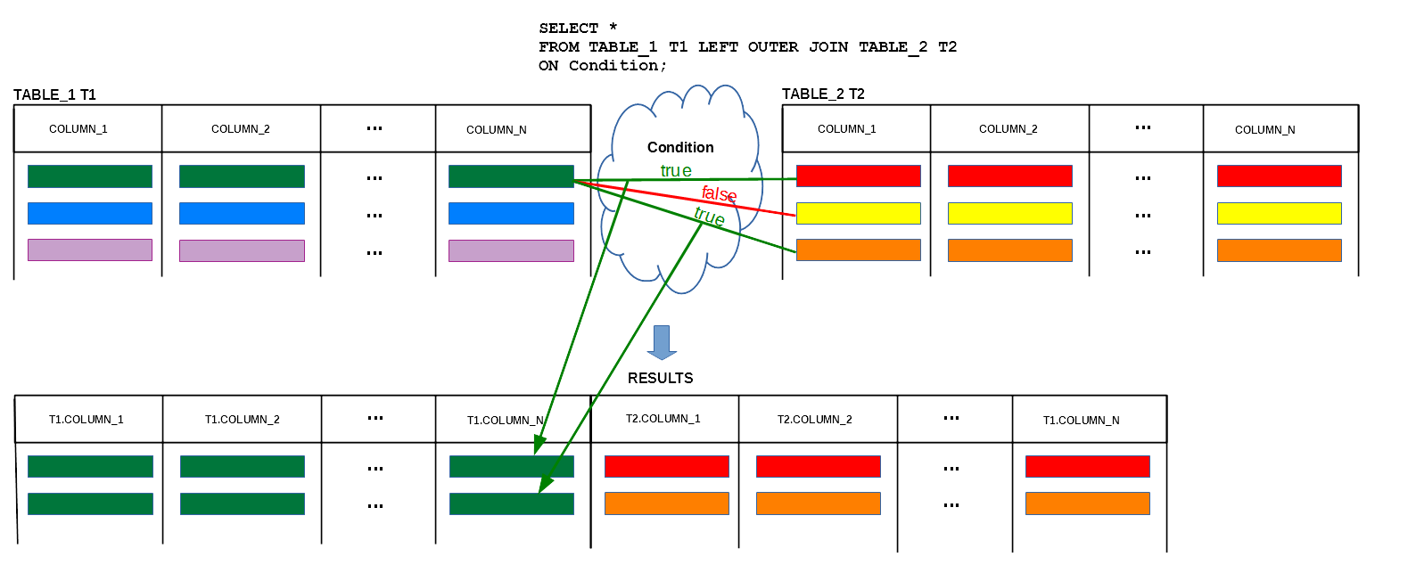
Left Outer Join queries
Left Outer Join operation joins the rows from two relational tables and appends to the results of join all rows from the left argument of the operation that cannot be joined with any row from the right argument of the operation with NULLs used in all places where the values are missing
7
Notes:
<!-- Neural, Brian, Male, British English. --><speak><break time="0.5s"/><prosody rate="90%">The operation of LEFT OUTER JOIN joins the rows from two relational tables and later on, it appends to the results all rows from the left argument of the operation, that cannot be joined with any row, from the right argument of the operation.<break time="0.3s"/>Such rows are extended with NULLs in all columns that belong to the right argument of the operation.<break time="0.3s"/>The present slide demonstrates the first step of the operation.<break time="0.3s"/>The rows from a relational table: TABLE 1, represented by an alias name: T 1, are joined with the rows from a relational table: TABLE 2, represented by an alias name T 2.<break time="0.3s"/>The join is performed over a given Condition in a usual way for the JOIN operation.<break time="0.3s"/>The join condition evaluates to TRUE, when a green row from T 1 is joined with a red row and orange row from T 2.<break time="0.3s"/>The join condition evaluates to FALSE when a green row from T1 is joined with a yellow row from T 2.<break time="0.3s"/>The intermediate results consist of two rows: green-red and green-orange.<break time="0.3s"/>The next slide explains the second step of the operation.<break time="0.5s"/></prosody></speak>
Systems Analysis
7

Slide 8
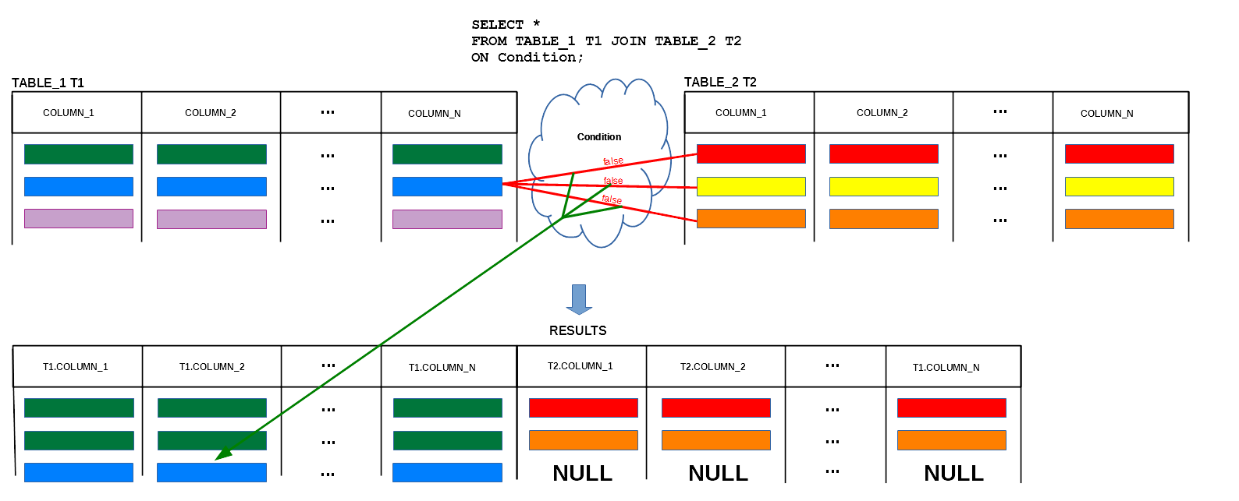
Left Outer Join queries
Left Outer Join operation joins the rows from two relational tables and appends to the results of join all rows from the left argument of the operation that cannot be joined with any row from the right argument of the operation with NULLs used in all places where the values are missing
8
Notes:
<!-- Neural, Brian, Male, British English. --><speak><break time="0.5s"/><prosody rate="90%">A blue row from a relational table T 1 cannot be joined with any row from a relational table T 2.<break time="0.3s"/>A relational table T 1 is the left argument of the LEFT OUTER JOIN operation and because of that, a blue row is added to the results of LEFT OUTER JOIN and the values in all columns, that belong to a relational table T 2 are set to NULL.<break time="0.3s"/>Please see a picture at the bottom of the present slide.<break time="0.3s"/>The unconditional addition of the rows from the left argument of the LEFT OUTER JOIN operation, is the difference between the JOIN operation, also called: INNER JOIN, and the LEFT OUTER JOIN OPERATION.<break time="0.5s"/></prosody></speak>
Systems Analysis
8

Slide 9
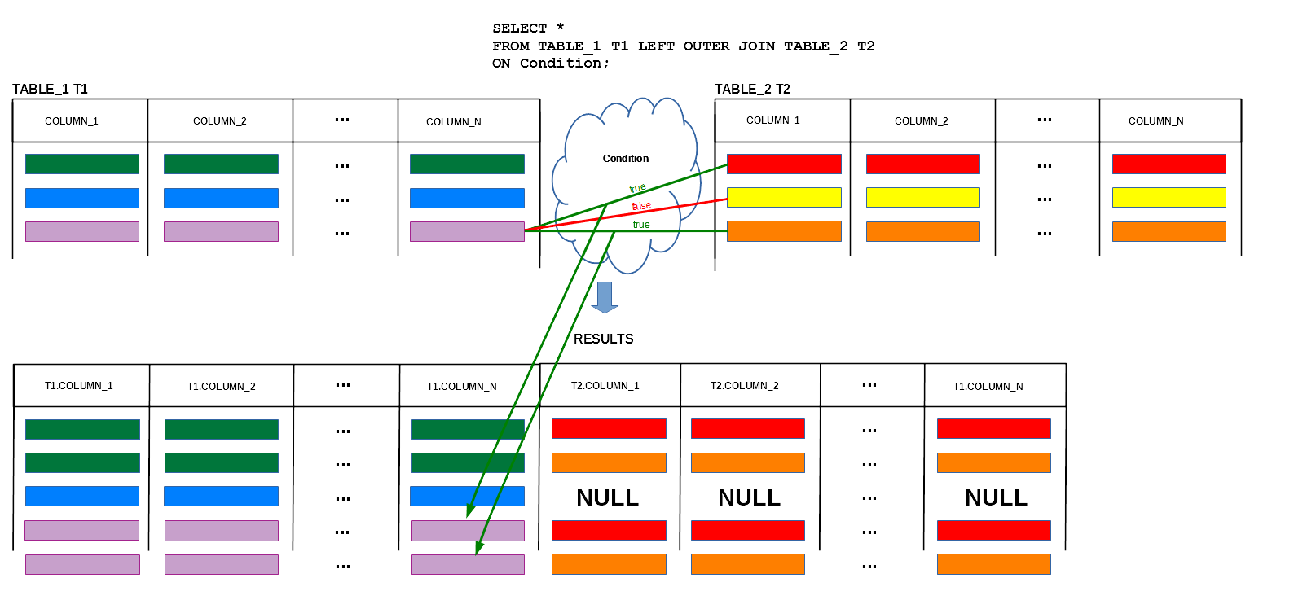
Left Outer Join queries
Left Outer Join operation joins the rows from two relational tables and appends to the results of join all rows from the left argument of the operation that cannot be joined with any row from the right argument of the operation with NULLs used in all places where the values are missing
9
Notes:
<!-- Neural, Brian, Male, British English. --><speak><break time="0.5s"/><prosody rate="90%">The join condition evaluates to TRUE, when a purple row from T 1 is joined with a red row and orange row from T 2.<break time="0.3s"/>The join condition evaluates to FALSE, when a purple row from T 1 is joined with a yellow row from T 2.<break time="0.3s"/>The rows: purple-red and purple-orange are added to the intermediate results.<break time="0.3s"/>It ends the processing of the LEFT OUTER JOIN operation.<break time="0.5s"/></prosody></speak>
Systems Analysis
9

Slide 10
Left outer join queries
Consider an extended version of the previous query: Find the names of departments together with the titles of all courses offered by each department and include the names of departments that offer no courses at all
SELECT name, title
FROM DEPARTMENT LEFT OUTER JOIN COURSE
ON name = offered_by;
An operation of LEFT OUTER JOIN includes into the results all rows from the "left" argument of the operation
If a row from the "left" argument of the operation cannot be joined with any row from the "right" argument of the operation then it is extended with NULLs and it is appended to the result
10
Notes:
<!-- Neural, Brian, Male, British English. --><speak><break time="0.5s"/><prosody rate="90%">Consider an extended version of the previous query: "find the names of departments, together with the titles of all courses offered by each department and, include the names of departments that offer no courses at all.<break time="0.3s"/>If a department offers no courses then its row in a relational table: DEPARTMENT, cannot be joined with any row in a relational table: COURSE.<break time="0.3s"/>If we would like to add to the results of the query all rows from a relational table: DEPARTMENT, that cannot be joined with any row from a relational table: COURSE, the we must apply the LEFT OUTER JOIN operation, instead of the JOIN operation and, we must use a name of a relational table: DEPARTMENT, as the left argument of the operation.<break time="0.3s"/>The SELECT statement, that implements the query is almost identical as the previous SELECT statement.<break time="0.3s"/>The only difference is: the LEFT OUTER JOIN operation, used instead of the JOIN operation. <break time="0.3s"/> Please see the SELECT statement in the middle of the present slide.<break time="0.3s"/>The operation of LEFT OUTER JOIN, includes into the results all rows from the left argument of the operation.<break time="0.3s"/>If a row from the "left" argument of the operation cannot be joined with any row from the right argument of the operation, then it is extended with: NULLs, in all columns that belong to the right argument and, it is appended to the result.<break time="0.5s"/></prosody></speak>
Systems Analysis
10

Slide 11
Left outer join queries
What are the outcomes of the following SELECT statement ?
SELECT name, title
FROM DEPARTMENT LEFT OUTER JOIN COURSE
ON name = offered_by;
+-------------+------+-------+--------+--------+ +---------+-----------+---------+-------------+
| name | code | t_s_n | chair | budget | | cnum | title | credits | offered_by |
+-------------+------+-------+--------+--------+ +---------+-----------+---------+-------------+
| Mathematics | MATH | 7 | Peter | 200.0 | | MATH101 | Calculus | 6 | Mathematics |
| Physics | PHY | 5 | Albert | 100.1 | | PHYS101 | Mechanics | 6 | Physics |
| Biology | BIOL | 0 | Mary | 0.0 | | MATH300 | Topology | 12 | NULL |
+-------------+------+-------+--------+--------+ +---------+-----------+---------+-------------+
The results of LEFT OUTER JOIN operation
+-------------+------+-------+--------+--------+---------+-----------+---------+-------------+
| name | code | t_s_n | chair | budget | cnum | title | credits | offered_by |
+-------------+------+-------+--------+--------+---------+-----------+---------+-------------+
| Mathematics | MATH | 7 | Peter | 200.0 | MATH101 | Calculus | 6 | Mathematics |
| Physics | PHY | 5 | Albert | 100.1 | PHYS101 | Mechanics | 6 | Physics |
| Biology | BIOL | 0 | Mary | 0.0 | NULL | NULL | NULL | NULL |
+-------------+------+-------+--------+--------+---------+-----------+---------+-------------+
11
Notes:
<!-- Neural, Brian, Male, British English. --><speak><break time="0.5s"/><prosody rate="90%">What are the outcomes of the SELECT statement with the operation of LEFT OUTER JOIN ?<break time="0.3s"/>Assume, that the contents of the relational tables: DEPARTMENT and COURSE, are as listed on the present slide.<break time="0.3s"/>Note, that a Department of Biology does not offer any courses and the Topology course has no departments assigned to it.<break time="0.3s"/>If we process the LEFT OUTER JOIN operation on the relational tables: DEPARTMENT and COURSE, then the results include the rows, that can be joined and a row from a relational table: DEPARTMENT, that cannot be joined with any row from a relational table: COURSE.<break time="0.3s"/>A row, that represents a Department of Biology is appended to the results of JOIN operation and it is extened with NULLs in all columns, that belong to a relational table: COURSE.<break time="0.3s"/>The results of the operation: DEPARTMENT LEFT OUTER JOIN COURSE, are visualised at the bottom of the present slide.<break time="0.5s"/></prosody></speak>
Systems Analysis
11

Slide 12
Left outer join queries
What are the outcomes of the following SELECT statement ?
SELECT name, title
FROM DEPARTMENT LEFT OUTER JOIN COURSE
ON name = offered_by;
The final results of PROJECTION on the columns name and title
+-------------+-----------+
| name | title |
+-------------+-----------+
| Mathematics | Calculus |
| Physics | Mechanics |
| Biology | NULL |
+-------------+-----------+
12
Notes:
<!-- Neural, Brian, Male, British English. --><speak><break time="0.5s"/><prosody rate="90%">The final result of a query, that finds the names of all departments together with the titles of the courses offered by the departments and includes the names of departments, that offer no courses, needs a projection of the results of the LEFT OUTER JOIN operation, on the columns: name and title.<break time="0.3s"/>The final results of the projections on the columns: name, from a relational table: DEPARTMENT and title: from a relational table COURSE, are visualised at the bottom of the present slide.<break time="0.5s"/></prosody></speak>
Systems Analysis
12

Slide 13
Outline
Outer join queries
Left outer join queries
Right outer join queries
Full outer join queries
Grouping revisited
13
Notes:
<!-- Neural, Brian, Male, British English. --><speak><break time="0.5s"/><prosody rate="90%">Right outer join queries.<break time="0.5s"/></prosody></speak>
Systems Analysis
13

Slide 14
Right outer join queries
Consider the following query: find the names of departments together with the titles of all courses offered by each department and include the titles of all courses do not assigned to any department
SELECT name, title
FROM DEPARTMENT RIGHT OUTER JOIN COURSE
ON name = offered_by
An operation of RIGHT OUTER JOIN includes into the results all rows from the "right" argument of the operation
If a row from the "right" argument of the operation cannot be joined with any row from the "left" argument of the operation then it is extended with NULLs and it is appended to the result
14
Notes:
<!-- Neural, Brian, Male, British English. --><speak><break time="0.5s"/><prosody rate="90%">Consider a query similar to the query implemented in the previous video clip.<break time="0.3s"/>This time, we would like to find the names of departments, together with the titles of all courses offered by each department, and include the titles of all courses, not assigned to any department yet.<break time="0.3s"/>If a course is not assigned to any department, then a row, that represents such a course in a relational table COURSE, cannot be joined with any row in a relational table: DEPARTMENT.<break time="0.3s"/>If we would like to add to the results, all rows from a relational table: COURSE, that cannot be joined with any row from a relational table: DEPARTMENT, then we must apply the operation of RIGHT OUTER JOIN, and we must use a name of a relational table: COURSE, as the right argument of the operation.<break time="0.3s"/>The SELECT statement, that implements the query, is almost identical as the SELECT statement, that used the LEFT OUTER JOIN operation.<break time="0.3s"/>Please see, the SELECT statement in the middle of the present slide.<break time="0.3s"/>The only difference is the RIGHT OUTER JOIN operation, used instead of the LEFT OUTER JOIN operation.<break time="0.3s"/>The operation of the RIGHT OUTER JOIN includes into the results all rows from the right argument of the operation.<break time="0.3s"/>If a row from the right argument of the operation, cannot be joined with any row from the left argument of the operation, then it is extended with NULLs in all columns, that belong to the left argument and, it is appended to the result.<break time="0.3s"/></prosody></speak>
Systems Analysis
14

Slide 15
Right outer join queries
What are the outcomes of the following SELECT statement ?
ELECT name, title
FROM DEPARTMENT RIGHT OUTER JOIN COURSE
ON name = offered_by;
+-------------+------+-------+--------+--------+ +---------+-----------+---------+-------------+
| name | code | t_s_n | chair | budget | | cnum | title | credits | offered_by |
+-------------+------+-------+--------+--------+ +---------+-----------+---------+-------------+
| Mathematics | MATH | 7 | Peter | 200.0 | | MATH101 | Calculus | 6 | Mathematics |
| Physics | PHY | 5 | Albert | 100.1 | | PHYS101 | Mechanics | 6 | Physics |
| Biology | BIOL | 0 | Mary | 0.0 | | MATH300 | Topology | 12 | NULL |
+-------------+------+-------+--------+--------+ +---------+-----------+---------+-------------+
The results of RIGHT OUTER JOIN operation
+-------------+------+-------+--------+--------+---------+-----------+---------+-------------+
| name | code | t_s_n | chair | budget | cnum | title | credits | offered_by |
+-------------+------+-------+--------+--------+---------+-----------+---------+-------------+
| Mathematics | MATH | 7 | Peter | 200.0 | MATH101 | Calculus | 6 | Mathematics |
| Physics | PHY | 5 | Albert | 100.1 | PHYS101 | Mechanics | 6 | Physics |
| NULL | NULL | NULL | NULL | NULL | MATH300 | Topology | 12 | NULL |
+-------------+------+-------+--------+--------+---------+-----------+---------+-------------+
15
Notes:
<!-- Neural, Brian, Male, British English. --><speak><break time="0.5s"/><prosody rate="90%">What are the outcomes of the SELECT statement with the operation of RIGHT OUTER JOIN ?<break time="0.3s"/>Assume, that the contents of the relational tables: DEPARTMENT and COURSE, are as listed in the present slide.<break time="0.3s"/>A course: Topology, is not assigned to any department yet.<break time="0.3s"/>If we process the RIGHT OUTER JOIN operation on the relational tables: DEPARTMENT and COURSE, then the results include the rows that can be joined and a row from a relational table: COURSE, that cannot be joined with any row from a relational table: DEPARTMENT.<break time="0.3s"/>The row that represents a course: Topology, is appended to the result of JOIN operation and it is extended with the NULLs in all columns that belong to a relational table: DEPARTMENT.<break time="0.3s"/>The results of operation: DEPARTMENT RIGHT OUTER JOIN COURSE, are visualised at the bottom of the present slide.<break time="0.5s"/></prosody></speak>
Systems Analysis
15

Slide 16
Right outer join queries
What are the outcomes of the following SELECT statement ?
SELECT name, title
FROM DEPARTMENT RIGHT OUTER JOIN COURSE
ON name = offered_by;
The final results of PROJECTION on the columns name and title
+-------------+-----------+
| name | title |
+-------------+-----------+
| Mathematics | Calculus |
| NULL | Topology |
| Physics | Mechanics |
+-------------+-----------+
16
Notes:
<!-- Neural, Brian, Male, British English. --><speak><break time="0.5s"/><prosody rate="90%">The final result of a query, that finds the names of all departments, together with the titles of the courses offered by the departments, and includes the titles of courses not assigned to any department yet, projects the results on the columns: name and title.<break time="0.3s"/>The final results of the projection on the columns: name from a relational table: DEPARTMENT and title: from a relational table COURSE are visualised at the bottom of the present slide.<break time="0.5s"/></prosody></speak>
Systems Analysis
16

Slide 17
Outline
Outer join queries
Left outer join queries
Right outer join queries
Full outer join queries
Grouping revisited
17
Notes:
<!-- Neural, Brian, Male, British English. --><speak><break time="0.5s"/><prosody rate="90%">Full outer join queries.<break time="0.5s"/></prosody></speak>
Systems Analysis
17

Slide 18
Full outer join queries
Full outer join SQL query is equivalent to a union of the results from left outer join and right outer join
Consider the following query: find the names of departments together with the titles of all courses offered by each department, and ...
... include the names of departments that offer no courses and ...
... include the titles of courses not offered by any department
SELECT name, title
FROM DEPARTMENT FULL OUTER JOIN COURSE
ON name = offered_by;
18
Notes:
<!-- Neural, Brian, Male, British English. --><speak><break time="0.5s"/><prosody rate="90%">Full outer join S Q L query is equivalent to a union of the results of the operations of LEFT OUTER JOIN and RIGHT OUTER JOIN.<break time="0.3s"/>Consider a query, that finds the names of departments together with the titles of all courses offered by each department and ...<break time="0.3s"/>... it includes the names of departments that offer no courses and ...<break time="0.3s"/>... it includes the titles of courses not offered by any department.<break time="0.3s"/>The query can be implemented as SELECT statement with the operation of FULL OUTER JOIN, in a way visualized in the present slide.<break time="0.3s"/>Such query is equivalent to a union of SELECT statement with the operation of LEFT OUTER JOIN and SELECT statement with the operation of RIGHT OUTER JOIN.<break time="0.3s"/>Both SELECT statements have been discussed in the latest two video clips.<break time="0.5s"/></prosody></speak>
Systems Analysis
18

Slide 19
Full outer join queries
MySQL does not support full outer join
Full outer join can be simulated in MySQL by UNION of SELECT statements that implement left outer join and right outer join
SELECT name, title
FROM DEPARTMENT LEFT OUTER JOIN COURSE
ON name = offered_by
UNION
SELECT name, title
FROM DEPARTMENT RIGHT OUTER JOIN COURSE
ON name = offered_by;
19
Notes:
<!-- Neural, Brian, Male, British English. --><speak><break time="0.5s"/><prosody rate="90%">Not all database systems implement the operation of FULL OUTER JOIN.<break time="0.3s"/>MySQL does not support the FULL OUTER JOIN.<break time="0.3s"/>On all systems, where the operation of FULL OUTER JOIN is not implemented, the operation can be simulated by the UNION of SELECT statements that implement the operations of LEFT OUTER JOIN and the RIGHT OUTER JOIN.<break time="0.3s"/>A sample implementation is given at the bottom of the present slide.<break time="0.3s"/>It is interesting, that the operation of the RIGHT OUTER JOIN, can also be implemented as the operation of LEFT OUTER JOIN when we swap the arguments.<break time="0.3s"/>It is true, that the operation of LEFT OUTER JOIN, on the relational tables: R and S, returns the same results as the operation of RIGHT OUTER JOIN, on the relational tables: S and R.<break time="0.3s"/>Then, a decision when the operation of LEFT OUTER JOIN or the RIGHT OUTER JOIN are used may depend on the political beliefs of an S Q L programmer.<break time="0.3s"/>Of course, please treat such conclusion as a joke.<break time="0.5s"/></prosody></speak>
Systems Analysis
19

Slide 20
Outline
Outer join queries
Left outer join queries
Right outer join queries
Full outer join queries
Grouping revisited
20
Notes:
<!-- Neural, Brian, Male, British English. --><speak><break time="0.5s"/><prosody rate="90%">Grouping revisited.<break time="0.5s"/></prosody></speak>
Systems Analysis
20

Slide 21
Grouping revisited
Do you remember the following query: Find the names of all departments together with the total number of all courses offered by each department
SELECT offered_by, COUNT(*)
FROM COURSE
GROUP BY offered_by;
What about the departments that offer no courses ?
Find the names of all departments together with the total number of all courses offered by each department and list the names of departments that offer no courses with a value 0
SELECT name, count(title)
FROM DEPARTMENT LEFT OUTER JOIN COURSE
ON DEPARTMENT.name = COURSE.offered_by
GROUP BY name;a
21
Notes:
<!-- Neural, Brian, Male, British English. --><speak><break time="0.5s"/><prosody rate="90%">Do you remember the following query: “find the names of all departments together with the total number of all courses offered by each department” ?<break time="0.3s"/>An implementation, that groups the rows in a relational table: COURSE, depending on the values in a column: offered by, does not include information about the departments, that offer no courses at all.<break time="0.3s"/>This is because a column: offered by, contains only the names of departments, that offer at least one course.<break time="0.3s"/>The original implementation of the query, is given at the top of the present slide.<break time="0.3s"/>So, how do we include into the answer, information about the departments that offer no courses ?<break time="0.3s"/>It means, that we would like to find the names of all departments, together with the total number of all courses offered by each department, and list the names of departments, that offer no courses with a value 0.<break time="0.3s"/>The departments that offer no courses, can be included into the answer by the operation: DEPARTMENT LEFT OUTER JOIN COURSE, with a join condition: DEPARTMENT dot name equals to COURSE dot offered by.<break time="0.3s"/>If we group the results from the operation of LEFT OUTER JOIN, by a column: name, then the names of departments, that offer no courses form the separate groups with the NULLs in a column: title.<break time="0.3s"/>Then, we count the total number of titles of courses in each group, that is located in a column title.<break time="0.3s"/>A group function: COUNT, when applied to an empty slot or an empty set of values, always returns 0.<break time="0.3s"/>An implementation of the query is given at the bottom of the present slide.<break time="0.5s"/></prosody></speak>
Systems Analysis
21

Slide 22
Grouping revisited
Find the names of all departments together with the total number of all courses offered by each department and list the names of departments that offer no courses with a value 0
SELECT name, count(title)
FROM DEPARTMENT LEFT OUTER JOIN COURSE
ON DEPARTMENT.name = COURSE.offered_by
GROUP BY name;
Note, that:
- we must use a relational table DEPARTMENT to get the names of all departments
- we must use LEFT OUTER JOIN (or RIGHT OUTER JOIN if a name of relational table DEPARTMENT is on the right hand side of OUTER JOIN operation) to include the names of departments that offer no courses
- we must count the values in a column title with COUNT(title) in the results of LEFT OUTER JOIN (and not the rows with COUNT(*))
22
Notes:
<!-- Neural, Brian, Male, British English. --><speak><break time="0.5s"/><prosody rate="90%">Please note, the following important details related to the implementation of a query, that finds the names of all departments together with the total number of all courses offered by each department.<break time="0.3s"/>We must use a relational table: DEPARTMENT, to get the names of all departments.<break time="0.3s"/>We must use the operation of LEFT OUTER JOIN, to include the names of departments that offer no courses.<break time="0.3s"/>We must use a group function: COUNT of title, to count the values in a column: title, obtained from the grouping by the names of departments.<break time="0.3s"/>We cannot count the rows with a function: COUNT star, because we are not looking for the total number of rows in each group.<break time="0.3s"/>We are looking for the total number of courses offered by each department and it means, the total number of values in a column: title, after grouping by the names of departments. <break time="0.5s"/></prosody></speak>
Systems Analysis
22

Slide 23
References
C. Coronel, S. Morris, A. Basta, M. Zgola, Data Management and Security, Chapters 5, 7, Cengage Compose eBook, 2018, eBook: Data Management and Security, 1st Edition
T. Connoly, C. Begg, Database Systems, A Practical Approach to Design, Implementation, and Management, Chapters 6.3.7 Multi-table Queries, Pearson Education Ltd, 2015
D. Darmawikarta, SQL for MySQL A Beginner’s Tutorial, Chapter 6, pages 62 - 63 Brainy Software Inc. First Edition: June 2014
How to ... ? Cookbook, How to implement queries in SQL ? (Part 2) Recipe 6.2 How to implement outer joins ?
23
Notes:
<!-- Neural, Brian, Male, British English. --><speak><break time="0.5s"/><prosody rate="90%">References.<break time="0.5s"/></prosody></speak>
Systems Analysis
23

